Slide 1


Aniran
Bachelor of Software Engineering
CRISP-DM for Smart Robot Navigation
Adviser : Dr.pirmohamadiani

Slide 2
>>> You can find all files in my github account :
https://github.com/aniranmp/smart-robot-navigation-kaggle
>>> This presentation is for university course
>>> You can find main reference of this title in References

Slide 3
Cross Industry Standard Process for Data Mining
Project objectives
Problem definition
Data collection
Insights
Dataset construction
Business Understanding
Data
Understanding
Data
Preparation
Deployment
Evaluation
Modeling
Purpose of model
Steps review
Business issues
Modeling techniques

Slide 4
Business Understanding
you’ll help robots recognize the floor surface they’re standing on using data collected from Inertial Measurement Units (IMU sensors).
The task is to predict which one of the nine floor types (carpet, tiles, concrete) the robot is on, using sensor data such as acceleration and velocity. Succeed and you'll help improve the navigation of robots without assistance across many different surfaces, so they won’t fall down on the job.
Requirements : A computer with Jupyter Notebook Installed and a team for analyzing the data

Slide 5
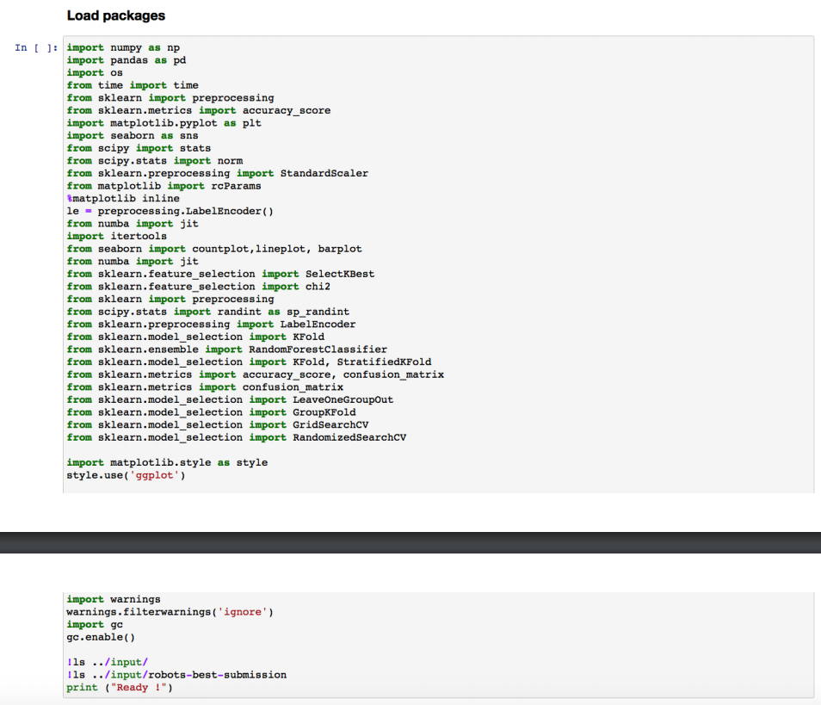
Data Understanding
Initial Data report:
These are necessary libraries for analyzing and visualizing
Sklearn
Seaborn
Matplotlib
Scipy
Pandas
Numpy
numba

Slide 6
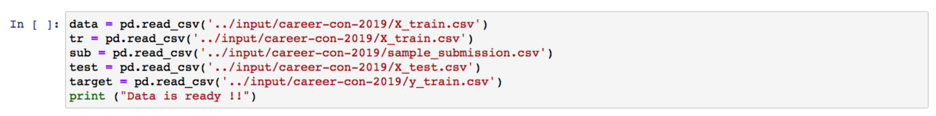
Data Understanding
Initial Data report
After importing libraries we import inputs

Slide 7
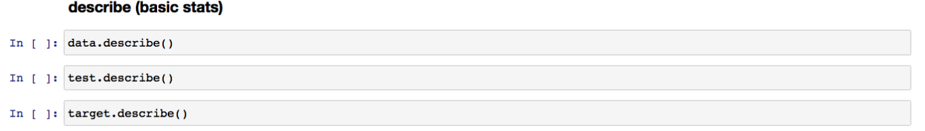
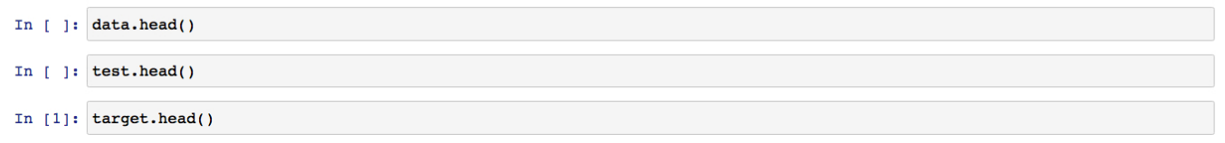
Data Understanding
Describe Data
Data Types
Surface : String / char
Others : number

Slide 8
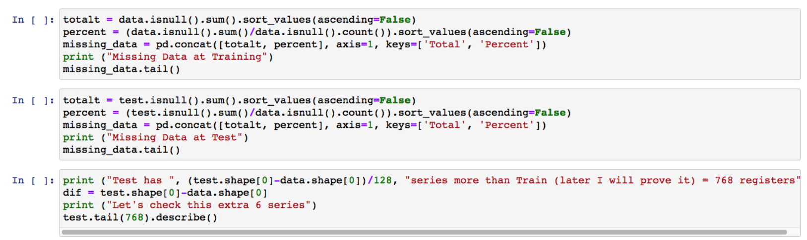
Data Understanding
Verify Data Quality

Slide 9
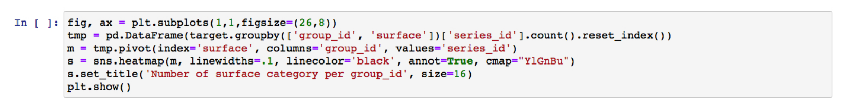
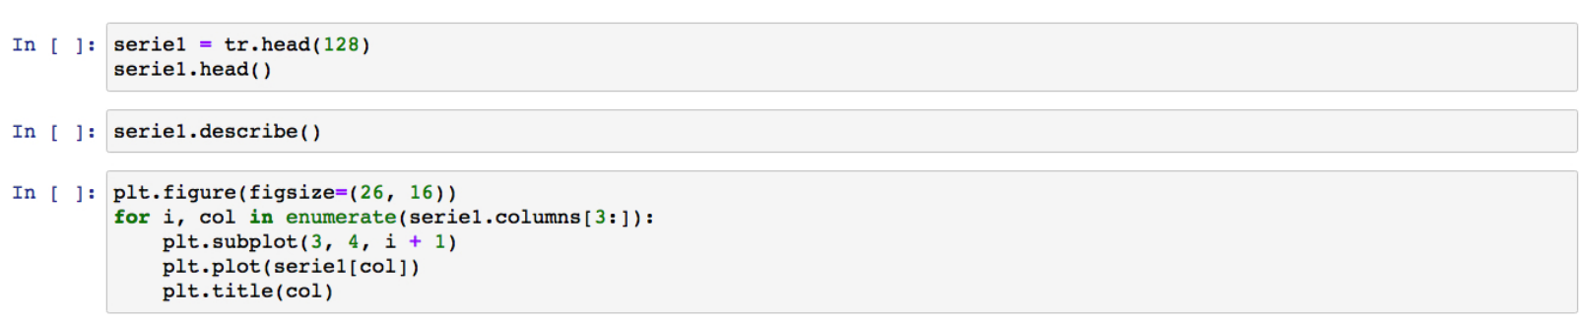
Data Understanding
Data Exploration

Slide 10
Data Understanding
Correlations test

Slide 11
Data Preparation
Data Selecting :

Slide 12
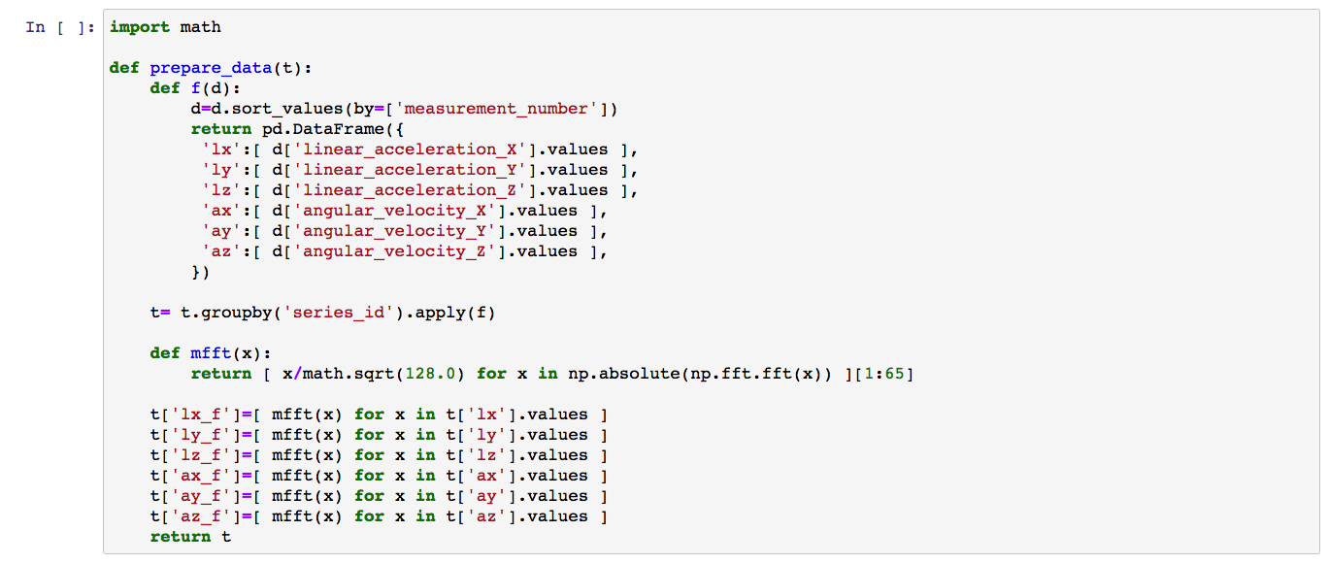
Data Preparation

Slide 13
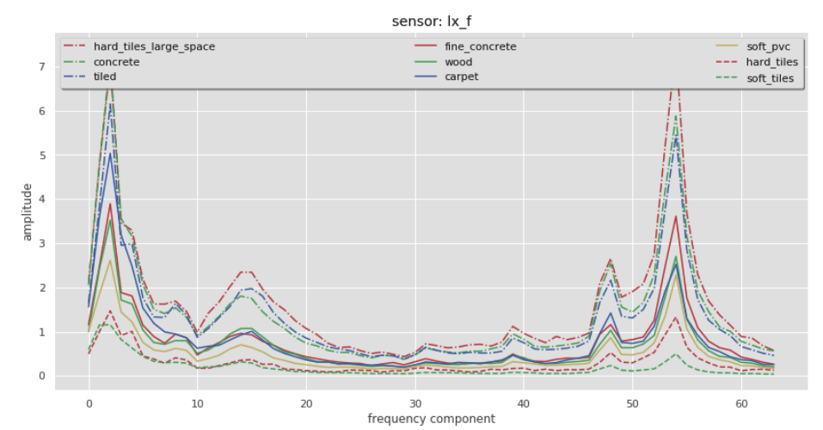
Data Preparation
Results : Actually There Are more results that can be checked in HERE

Slide 14
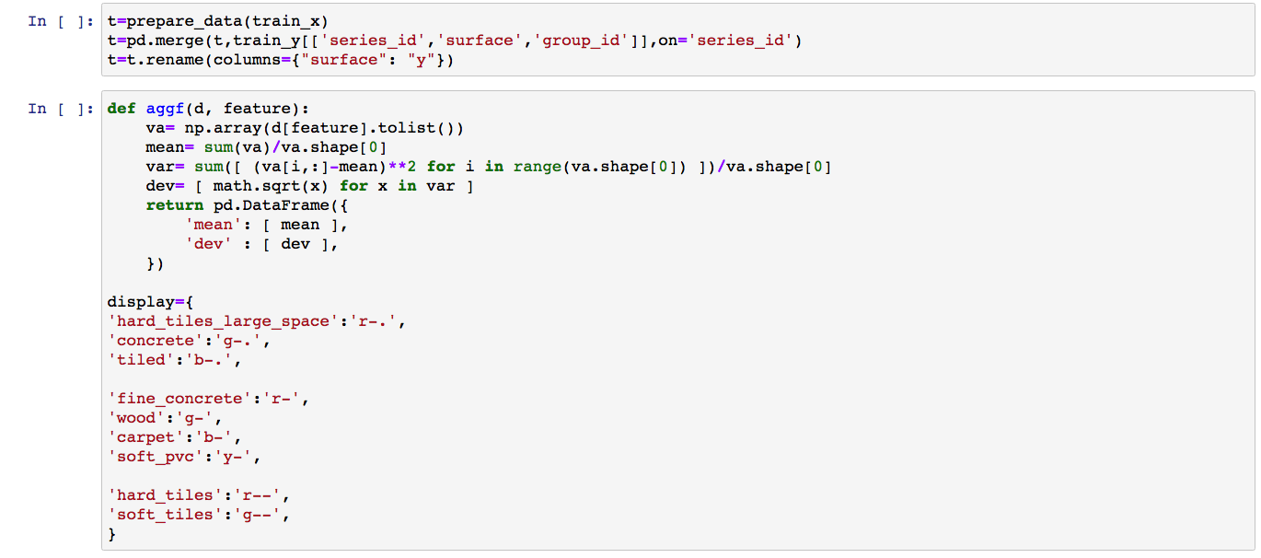
Data Preparation
data Integration

Slide 15
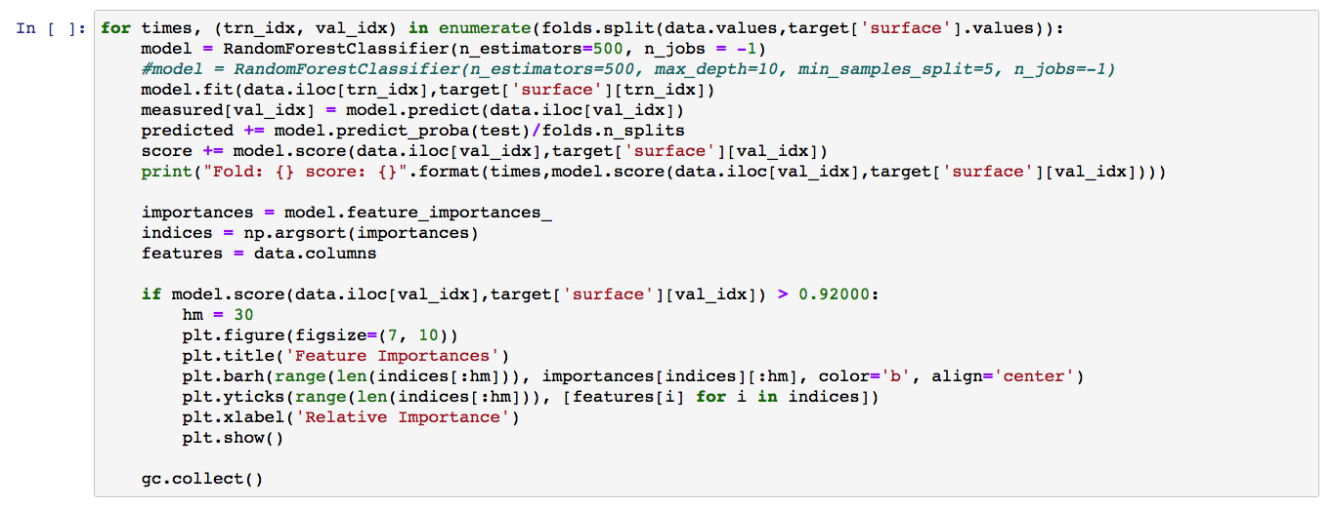
Modeling

Slide 16
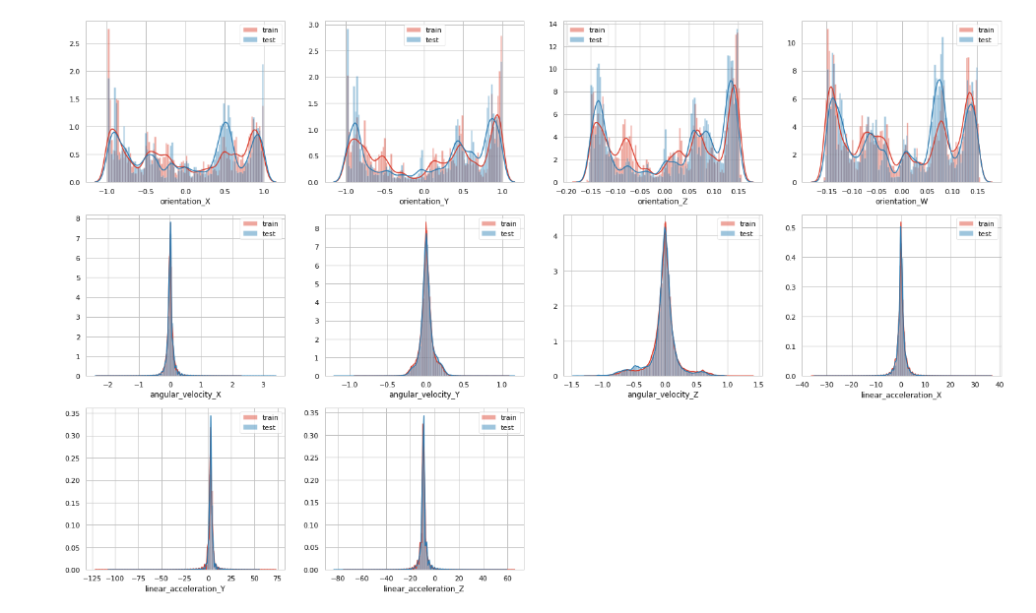
Modeling

Slide 17
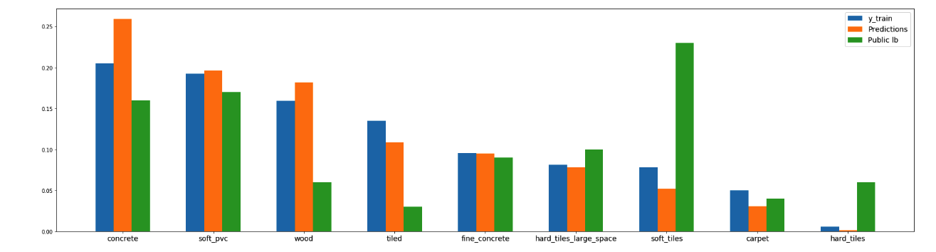
Evaluation
There are much less surfaces like wood or tiled, and much more soft and hard tiles in public leaderboard. This can be issue, why CV and LB results differ strangely.

Slide 18
Results
There Are Multiple results but for decreasing in pages we decided to leave them for yourself, you’ll see one of the results in next slide.

Slide 19
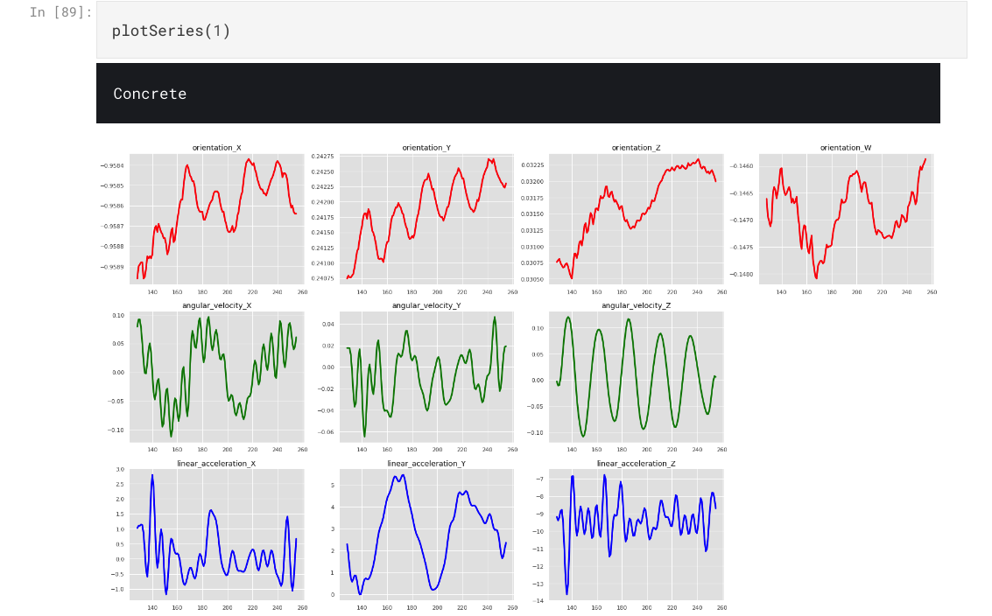
Results

Slide 20
References
https://www.kaggle.com/jesucristo/1-smart-robots-most-complete-notebook#DATA
https://Crisp-dm-Analysis-Template.ipynb
BI-CRISP-DM.pdf

Slide 21

University of Kurdistan
+98 922-507-5801
iot.uok.ac.ir/aniran-mohammadpour/
Aniran.mp@gmail.com
Thank You
Notes:
Image source:-
https://pixabay.com/en/coding-programming-working-macbook-924920/

